Slide 1
Data Structures and Algorithms -3 (25CS2103E) Intelligent Student Record System
Team Members:
2520030091-K.Rupesh
2520030126-D.Siri Reddy
252030230-K.Hemanth
Under the Esteemed Guidance of Dr.V.Sireesha

Slide 2
Contents
Abstract
Introduction
Literature survey
Problem Statement and Objectives
Hardware and Software requirements
Results
Conclusion
Future Scope

Slide 3
Abstract
The Intelligent Student Record System is a software application developed to efficiently store, manage, organize, and retrieve student information using Data Structures and Algorithms (DSA). In traditional systems, managing a large number of student records manually can be time-consuming and may lead to errors or difficulty in finding specific information. This system provides a simple and efficient solution by maintaining student details such as Student ID, Name, Age, Department, Marks, Attendance, and Grade in an organized manner. Various DSA concepts such as arrays, linked lists, searching, sorting, and tree-based structures can be used to improve the performance of the system. The system allows users to add new student records, update existing details, delete records, search for a particular student, and sort students based on marks or other information. Searching techniques such as linear search, binary search, pattern search, and fuzzy search can also be implemented to make finding student information faster and more flexible. By applying DSA concepts, the system reduces manual effort, improves data organization, and provides faster access to student records. Overall, the Intelligent Student Record System demonstrates the practical use of Data Structures and Algorithms in solving a real-world problem and helps students understand how programming concepts can be applied to develop an efficient and user-friendly application.

Slide 4
Introduction
Managing student records is an important task in schools and colleges because a large amount of student information has to be maintained regularly. When records are managed manually, it can be difficult and time-consuming to find, update, or organize specific student details. The Intelligent Student Record System provides a simple solution to this problem by storing all student information in an organized format. Using Data Structures and Algorithms, the system can quickly perform operations like searching, sorting, adding, updating, and deleting records. Different searching techniques can be used to make the system more useful and faster. The system is designed to be easy to use, accurate, and efficient, while also helping students understand the practical applications of DSA in real-life software systems.

Slide 5
Literature Survey
Existing student record systems are mainly used to store details such as student ID, name, marks, attendance, and department. Traditional systems use basic searching and sorting methods, which may become slow when the number of records increases. Studies show that Data Structures and Algorithms can make record management faster and more organized. Techniques like arrays, linked lists, sorting, linear search, binary search, pattern search, and fuzzy search can be used to efficiently manage and find student records. The proposed system applies these DSA concepts to create a simple, fast, and user-friendly student record management system.

Slide 6
Problem Statement and Objectives
Problem Statement:
Managing a large number of student records manually is time-consuming and difficult. Finding, updating, sorting, and maintaining student information can also lead to errors. Therefore, there is a need for a simple system that can store student records efficiently and quickly search and manage the required information using Data Structures and Algorithms.
Objectives:
To store student records in an organized manner.
To provide fast searching of student information.
To add, update, and delete student records easily.
To sort student records based on name, ID, or marks.
To implement pattern search and fuzzy search for flexible searching.
To apply DSA concepts to solve a real-world problem.
To reduce manual work and save time and effort.

Slide 7
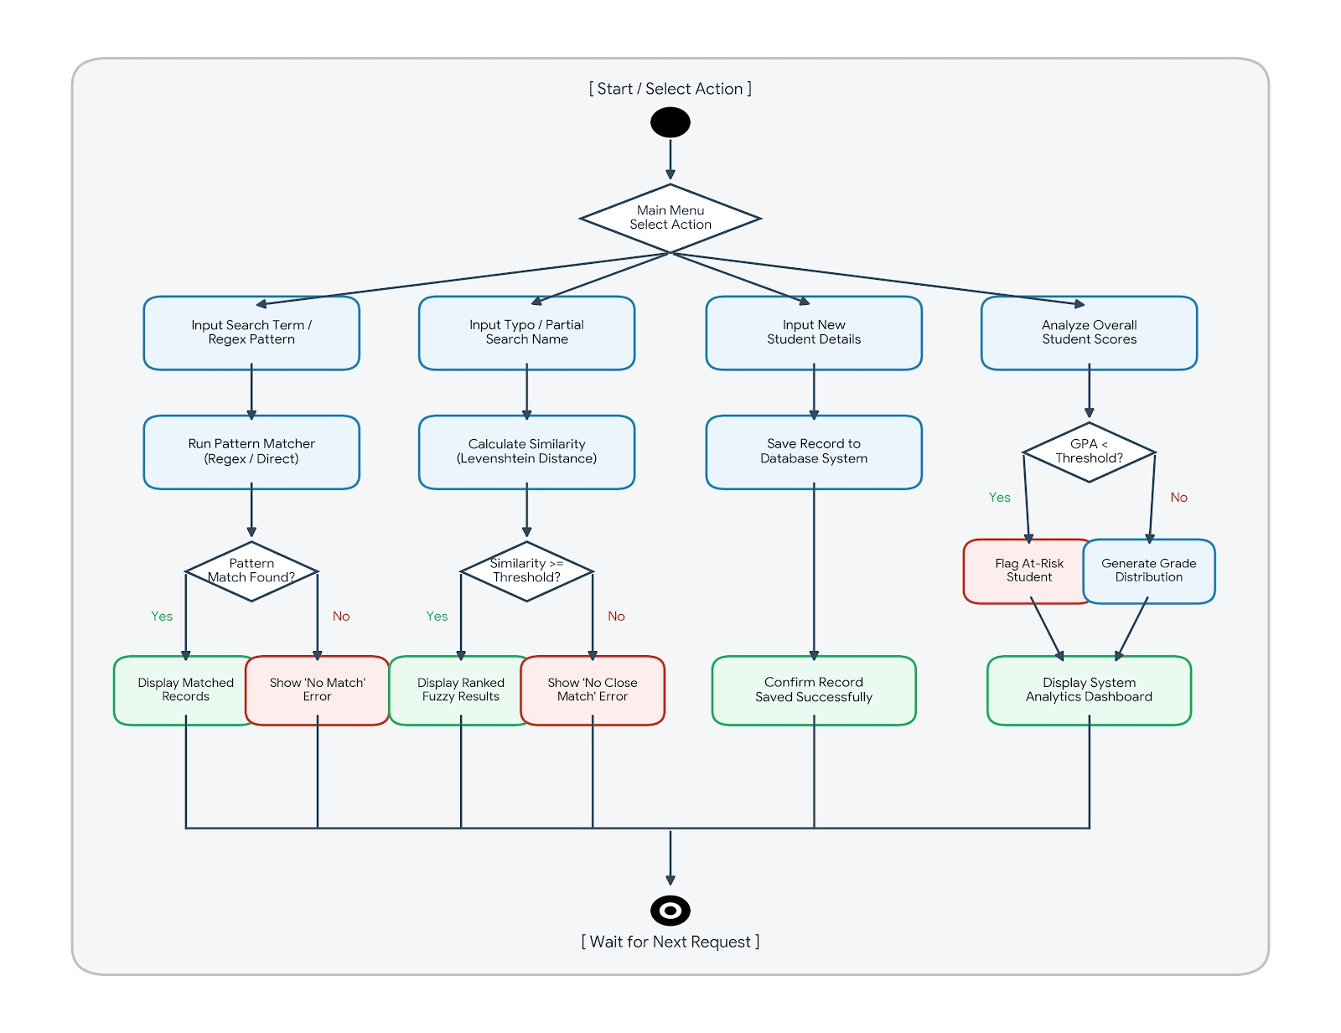
Flow Chart

Slide 8
Results
The Intelligent Student Record System provides an efficient and organized way to manage student information. The system successfully stores details such as student ID, name, department, marks, attendance, and grades and allows users to access them easily. Operations like adding, updating, deleting, and sorting records can be performed without much effort. The searching feature helps users quickly find a particular student's information from the available records. The project reduces the time and effort required to manage student information manually. It also improves the organization and accuracy of records and makes information retrieval faster. Through this project, the importance of choosing suitable data structures and searching algorithms for solving real-world problems can be clearly understood. Overall, the system achieves its main goal of providing a simple, fast, efficient, and user-friendly solution for student record management.

Slide 9
Hardware and Software requirements
Hardware Requirements:
Processor: Intel Core i3 or above
RAM: Minimum 4 GB
Storage: Minimum 10 GB free space
Keyboard and Mouse
Monitor/Desktop or Laptop
Internet Connection: Optional, for installing software and libraries
Software Requirements:
Operating System: Windows 10/11, Linux, or macOS
Programming Language: Java
IDE: Visual Studio Code
JDK: Java Development Kit (JDK 8 or above)
Data Storage: CSV file / Text file
Version Control: Git/GitHub

Slide 10
Conclusion
The Intelligent Student Record System shows how Data Structures and Algorithms can be used to make student data management easier and more effective. Instead of handling records manually, the system provides a structured way to store and access student information. Features like searching, sorting, updating, and deleting records improve the overall management of data. The use of pattern search and fuzzy search also makes finding records more convenient. Through this project, we understand the importance of selecting suitable data structures and algorithms for faster and better data processing. Overall, the project is a practical application of DSA that provides a simple, reliable, and efficient approach to student record management.

Slide 11
Future Scope
Develop a web-based version that can be accessed from anywhere.
Add a login and authentication system for students, teachers, and administrators.
Store records in a database instead of only CSV files.
Add AI-based search for more accurate student record retrieval.
Improve fuzzy search to handle spelling mistakes and incomplete names.
Add student performance analysis using marks and attendance data.
Generate reports and charts for student performance.
Add cloud storage for secure and easy access to records.
Develop a mobile application for students and teachers.
Improve the system to handle large numbers of student records efficiently.

Slide 12
Thank you

